Slide 1



Japan Used Cars Price Prediction
This project focuses on predicting the price of used cars in Japan. The dataset was scraped from tc-v.com, a popular online marketplace for used cars in Japan. It includes 10 features for each car, providing valuable insights into the factors influencing used car pricing in the Japanese market.
by Yuva Karthikeswar Dadisetty
AI/ML Intern

Slide 2
Problem Statement
Cars' data was scraped from tc-v.com and it included Information about Japan's largest online used car marketplace. Ten features were assembled for each car in the dataset
• This dataset includes 10 features:
Feature, Type, Description
1. Price -----> The sale price of the vehicle in the ad
2. Mark -----> The brand of car
3. Model -----> Model of the vehicle
4. Year -----> The vehicle registration year
5. Mileage -----> miles traveled by vehicle
6. Engine capacity -----> The measurement of the total volume of the cylinders in the engine
7. Transmission -----> The type of gearbox used by the car
8. Drive -----> Wheel drive(2wd, 4wd and awd)
9. Hand drive -----> Left-hand traffic (LHT) and right-hand traffic (RHT)
10. Fuel -----> The type of fuel used by the car( gasoline, diesel, hybrid, lpg and cng)
Predict the price of an unknown car.

Slide 3

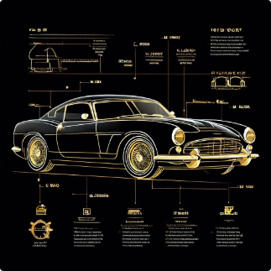
Features of the Dataset
1
Price
2
Make
The sale price of the vehicle in the ad.
The brand of the car.
3
Model
4
Years
The specific model of the vehicle.
The vehicle's registration year.

Slide 4


Features of the Dataset (Continued)
1
Mileage
The total miles traveled by the vehicle.
2
Engine Capacity
The total volume of the cylinders in the engine.
3
Transmission
The type of gearbox used by the car.
4
Drive
The wheel drive system (2WD, 4WD, AWD).

Slide 5

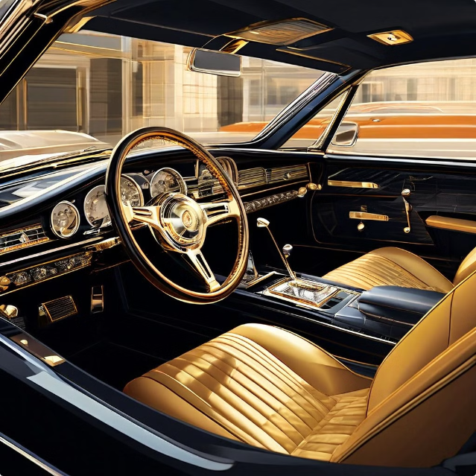
Features of the Dataset (Continued)
1
Hand Drive
Whether the car is left-hand drive (LHT) or right-hand drive (RHT).
2
Fuel
The type of fuel used by the car (gasoline, diesel, hybrid, LPG, CNG).

Slide 6

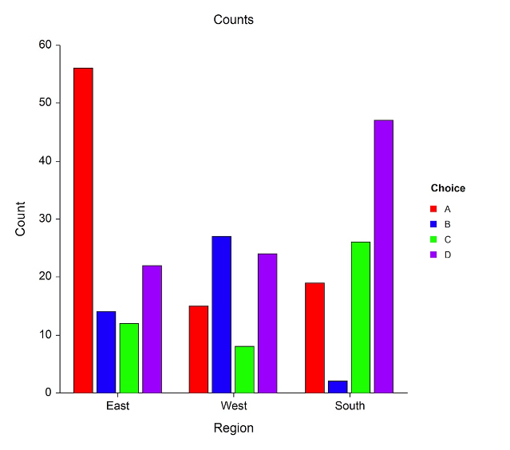
Predictive Modeling
The goal of this project is to develop a predictive model that can accurately estimate the price of a used car based on the available features. This model will be trained on the provided dataset and will be able to predict the price of a new, unseen car.

Slide 7
Data Cleaning & Pre-processing
Import Necessary Libraries
Read CSV file
Re-indexing the columns
Removing the Irrelevant Columns
Summary of the Dataset
Data types in the dataset
Checking Null Values
Checking Duplicated Values

Slide 8
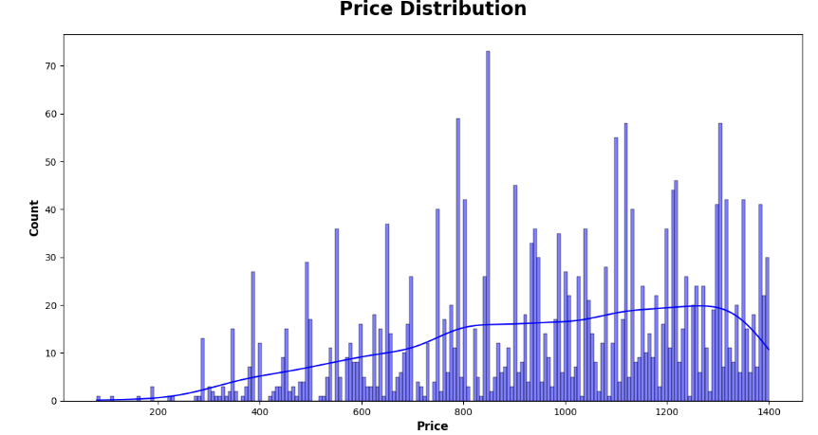
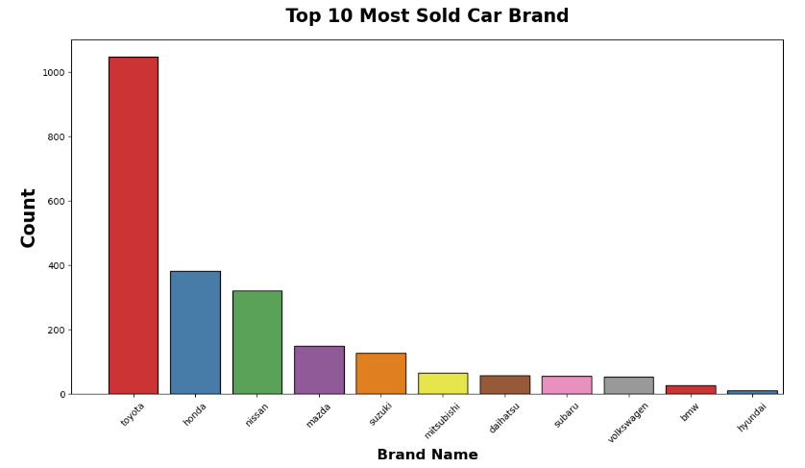
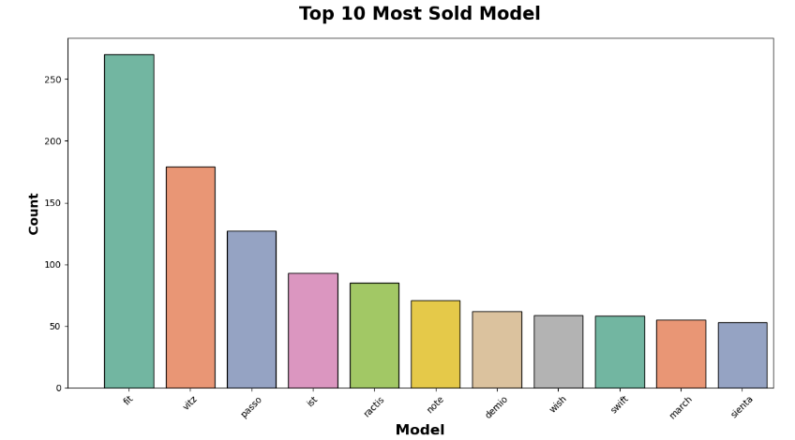
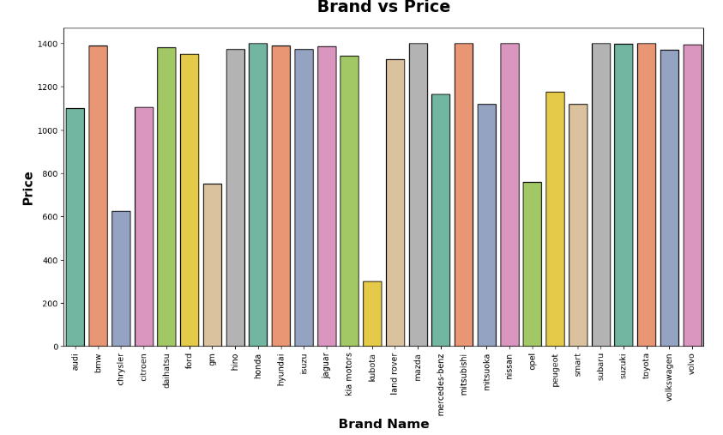
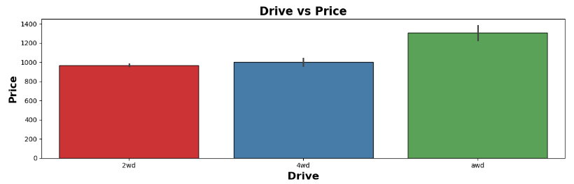
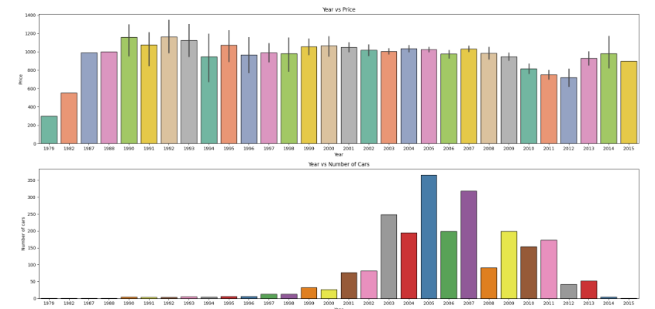
Data Visualization

Slide 9
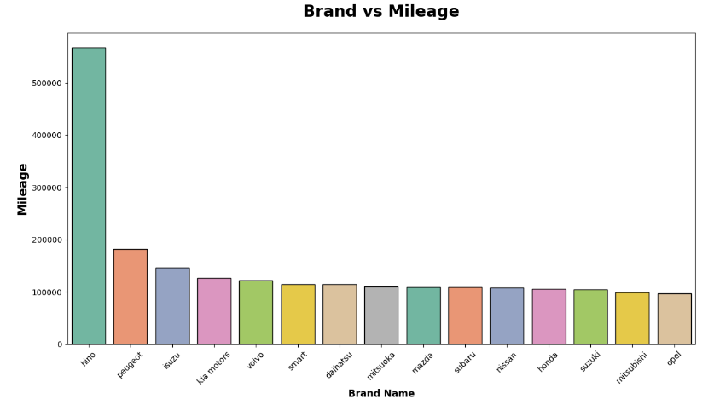
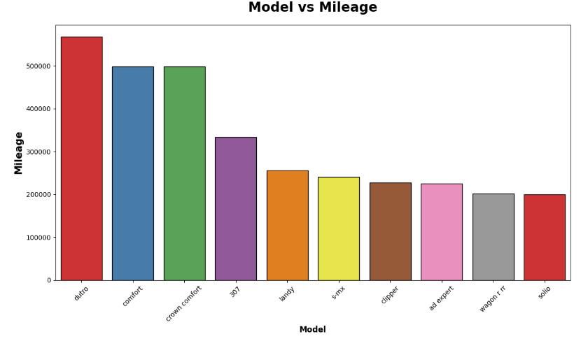
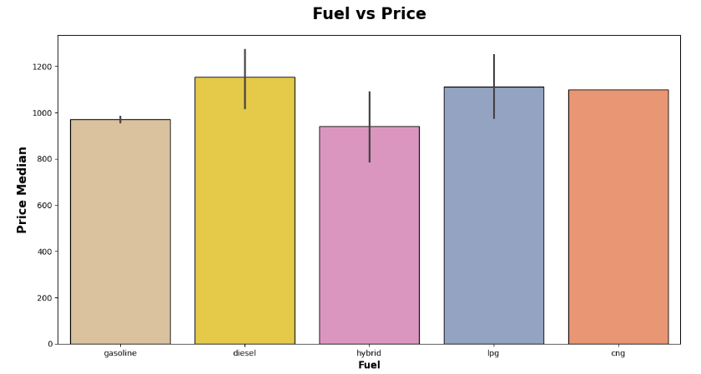
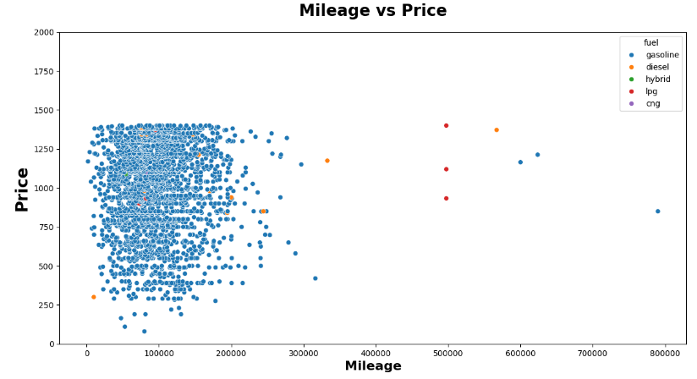
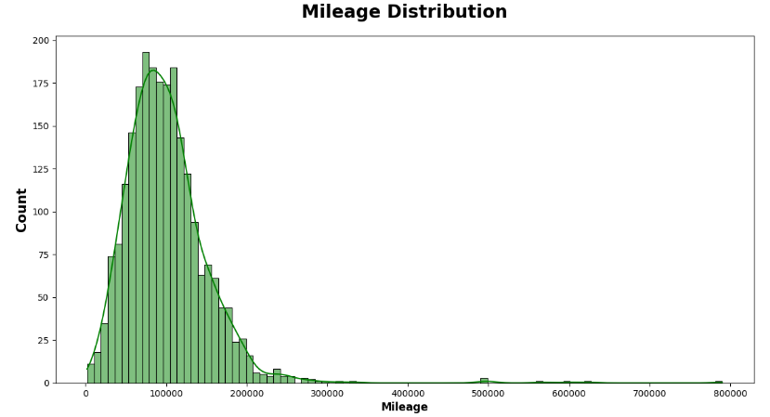
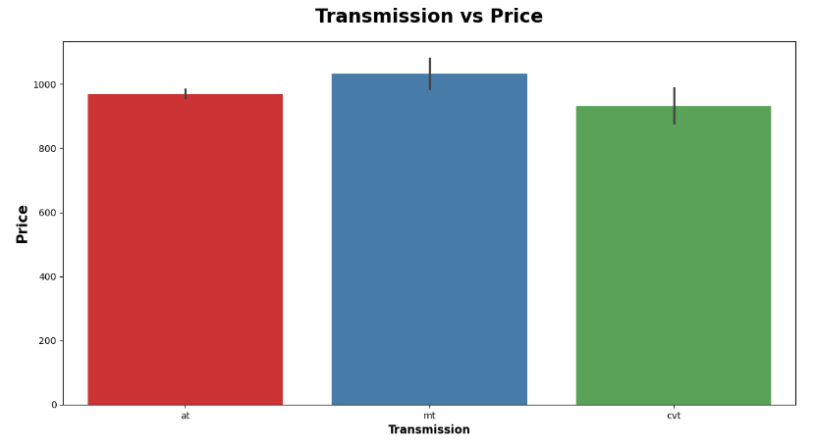
Data Visualization

Slide 10
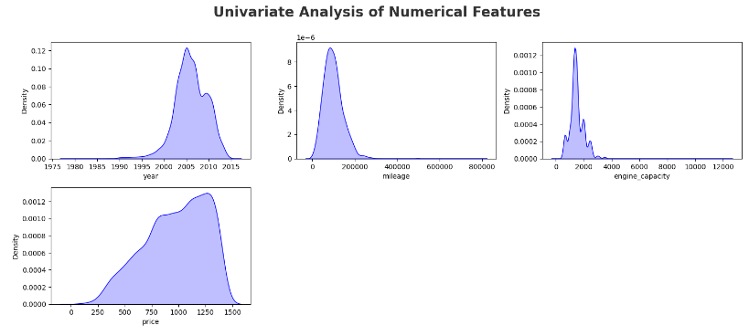
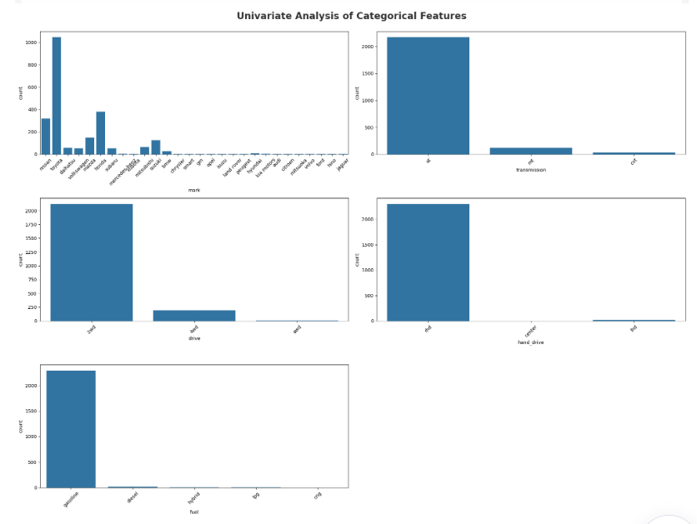
Exploratory Data Analysis (EDA)

Slide 11
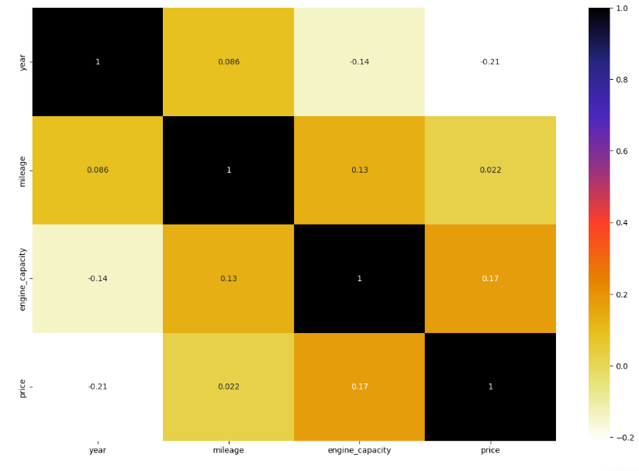
Exploratory Data Analysis (EDA)
Multivariate Analysis

Slide 12


Model Selection
Various machine learning algorithms can be used for price prediction. Some popular options include linear regression, decision trees, random forests, and support vector machines. The choice of algorithm will depend on the characteristics of the dataset and the desired level of accuracy.

Slide 13

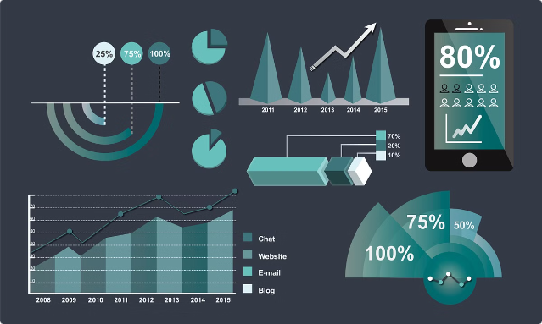
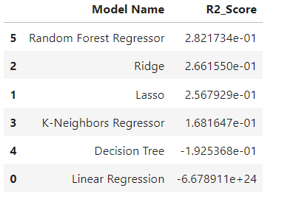
Model Evaluation
Once the model is trained, it needs to be evaluated to assess its performance. This involves splitting the dataset into training and testing sets. The model is trained on the training set and then evaluated on the testing set to measure its ability to predict prices accurately on unseen data.
Results of All Models
We are presenting the results of all models that have been utilized to assess the accuracy of this dataset. The results are showcased here.

Slide 14

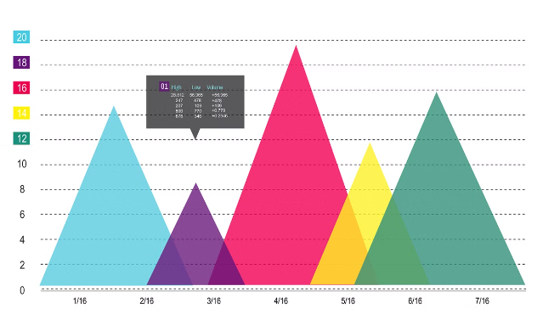
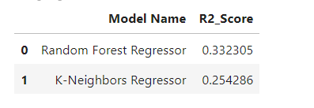
Model Optimization
After evaluation, the model may require optimization to improve its performance. This can involve adjusting hyperparameters, feature engineering, or trying different algorithms. The goal is to find the best model configuration that achieves the desired level of accuracy.
Results of Re-Trained Models
After evaluation, Displaying the results of the retrained models; these are presented here

Slide 15


Conclusion
This project aims to develop a robust and accurate price prediction model for used cars in Japan. By leveraging the provided dataset and applying appropriate machine learning techniques, we can gain valuable insights into the factors influencing used car pricing that can assist buyers and sellers in making informed decisions.

Slide 16
Thank You

